Slide 1
SF Neighborhoods – Clustered by Restaurant Price

Slide 2
Introduction
Can we find where we can eat cheap or expensive in SF?
Visualize locational representation of where we might find cheaper/more expensive restaurants in SF
We will use FourSquare and K-Means clustering to provide a map suggesting possible locations for restaurants of different types.

Slide 3
Data
List of SF neighborhoods: https://sfplanning.org/resource/neighborhood-group-organizations
Use Nominatim from geopy to identify coordinates of each neighborhood, use Google Maps or Wikipedia if Nominatim returns null or missing data
Use FourSquare to find restaurants in each price bucket in a 500 meter radius from each neighborhood’s coordinates
Used segmentation to organize restaurants by price in 4 separate clusters

Slide 4
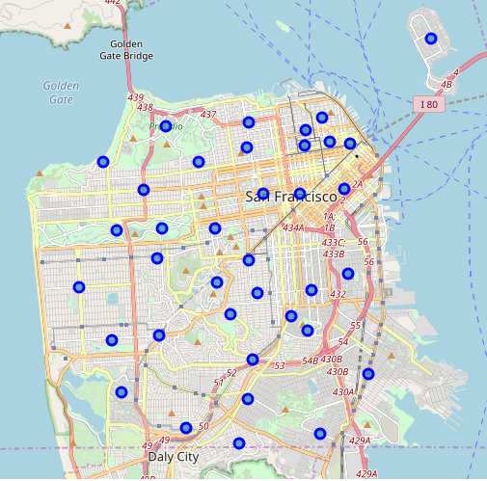
Results Background
Using Folium, we uncovered our map of SF based on neighborhood coordianates

Slide 5
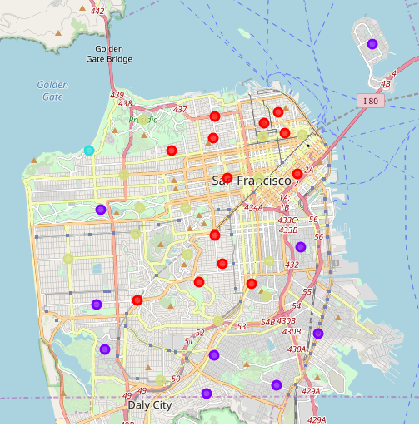
Results
Results after clustering
Red: $$$$
Green: $$-$$$
Purple: $-$$
$ = (least expensive)
$$$$ = most expensive

Slide 6
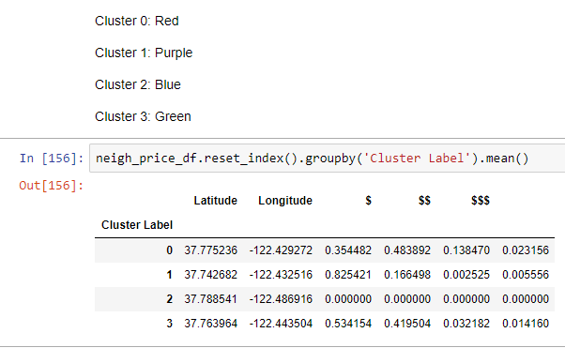
Results Data
Means of the frequency of each bucket of restaurant is given here, supporting the classification of each cluster given last slide

Slide 7
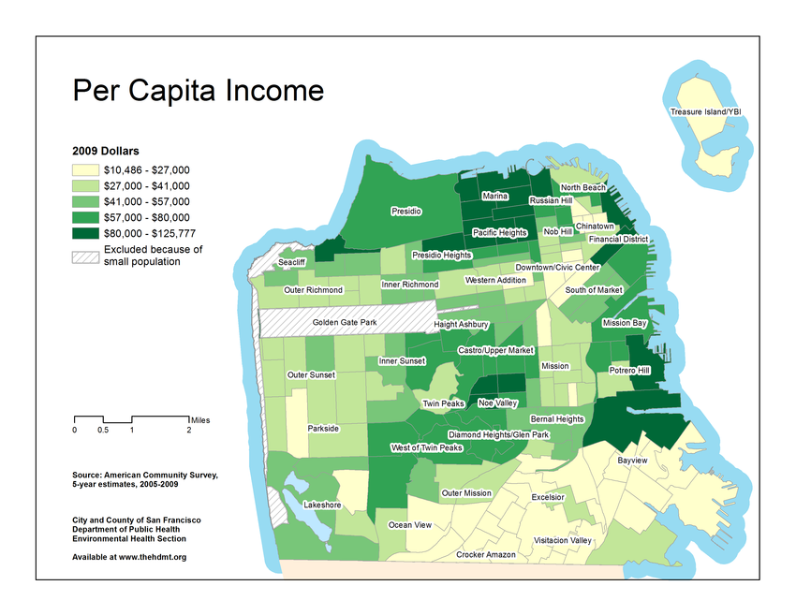
Discussion
Similarities to Per Capita Income exist, but it’s not 1:1
Poorer neighborhoods may have more expensive restaurants
People travel outside of their immediate neighborhoods to eat at restaurants whose prices don’t match up with the are they live in.

Slide 8
Discussion
The clusters were separated based on location based purely on kmeans clustering
Geography is related to restaurant pricing. More expensive neighborhoodstend to have more expensive restaurants
The Downtown/Civic Center, Chinatown, and Nob Hill neighborhoods are exceptions, as they are Green clustered neighborhoods within a location of mostly Red clusters.
Restauranteurs can focus on each cluster to reflect where he or she may want to open
Can use dissimilarity to ope restaurant with less nearby competition

Slide 9
Conclusion
Using Nominatim/Folium/FourSquare/Kmeans clustering, similar neighborhoods have been mapped out with restaurant pricing data. This can be used to help a restaurateur choose where to put a new restaurant.
Future study:
  restaurant pricing vs average income comparison
  types of restaurants in each area (Indian, Mexican, Italian etc.)
  Density of restaurants in each neighborhood
  Diversity of price ranges in each neighborhood

